Slide 1
Startup blueprint generator agent
IBM HACKATHON PROJECT
Presented By: Dev B Solanki
Student name :Dev Bharatkumar Solanki
College Name & Department : Institute Of Advance Research B.Tech(CE)

Slide 2
OUTLINE
Problem Statement
Technology used
Wow factor
End users
Result
Conclusion
Git-hub Link
Future scope
IBM Certifications

Slide 3
Problem Statement
Many aspiring entrepreneurs struggle to turn their startup ideas into reality due to a lack of knowledge, planning tools, and access to resources. They face hurdles in market research, funding, legal compliance, and business modeling.
Proposed Solution: The Startup Blueprint Generator Agent, built using IBM Watsonx and RAG technology, solves this by transforming simple startup ideas into detailed business blueprints. It provides market insights, investor suggestions, legal steps, and go-to-market plans — all from a single prompt.

Slide 4
Technology used
IBM cloud lite services
Natural Language Processing (NLP)
Retrieval Augmented Generation (RAG)
IBM Granite model

Slide 5
IBM cloud services used
IBM Cloud Watsonx AI Studio
IBM Cloud Watsonx AI runtime
IBM Cloud Agent Lab
IBM Granite foundation model 3-3-8b instruct

Slide 6
Wow factors
This agent will significantly reduce research time, improve the quality of literature reviews, help early-stage aspiring entrepreneurs find direction, and foster interdisciplinary collaboration by making knowledge more accessible and actionable.
Unique features:
Transforms a raw startup idea into a complete, structured business plan instantly. Uses real-time data via Retrieval-Augmented Generation (RAG) for fact-based suggestions.
Recommends government schemes, legal steps, and potential investors automatically.
Acts like a 24/7 AI co-founder, reducing weeks of planning to just minutes.

Slide 7
End users
Student entrepreneurs
Early-stage startup founders
Incubators and accelerators
Innovation cells and startup mentors
Educational institutes offering entrepreneurship programs

Slide 8
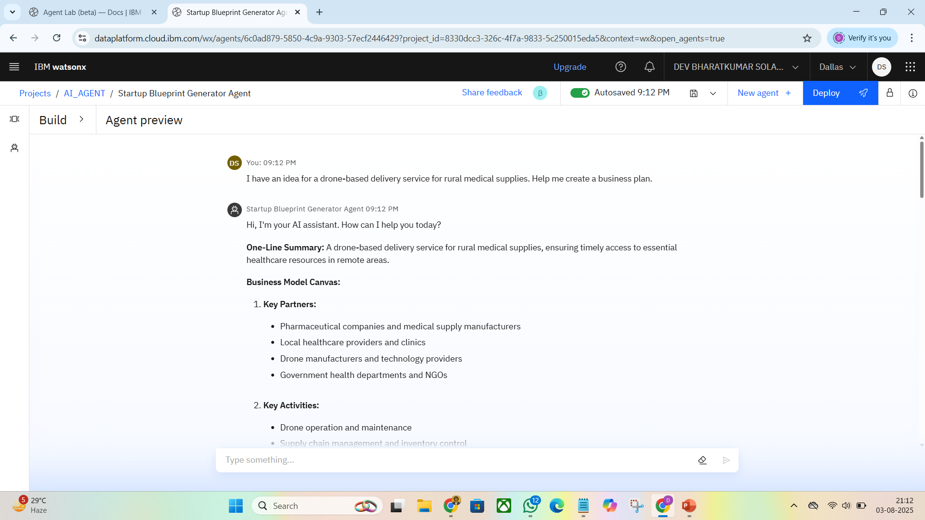
Results

Slide 9
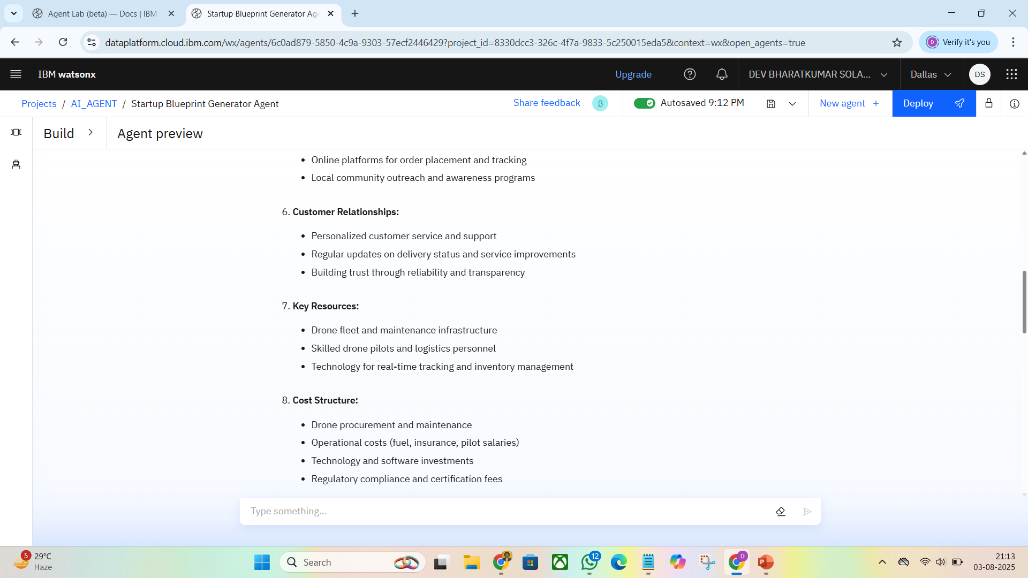
Results

Slide 10
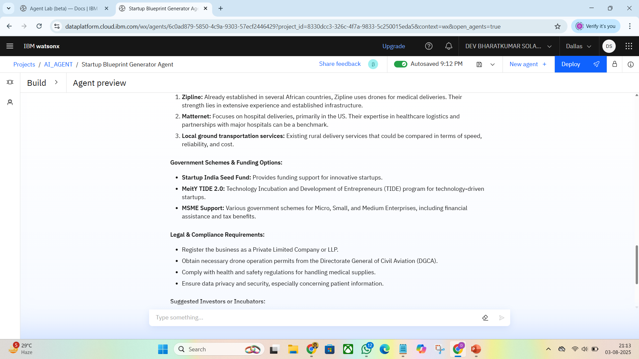
Results

Slide 11
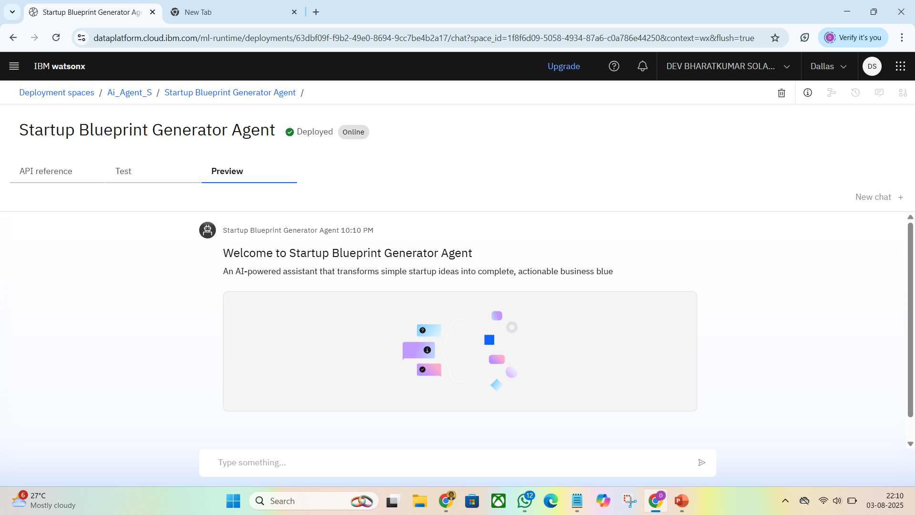
Results
Deployed AI Agent

Slide 12
Conclusion
Transforms rough startup ideas into structured business blueprints.
Saves time by providing instant, AI-powered market and legal insights.
Ideal for first-time founders seeking clarity and direction.

Slide 13
GitHub Link
Make sure that there should be readme file :-
# SUBP-Ai-Agent
An AI-powered agent that transforms simple startup ideas into full-fledged business blueprints, including business model canvas, GTM strategy, legal checklist, competitor analysis, and funding suggestions – all generated intelligently with real-time context.
https://github.com/D03SOLANKI/SUBP-Ai-Agent

Slide 14
Future scope
Add real-time funding APIs
Enable voice inputs
Auto-generate pitch decks
Suggest mentors
Support regional languages

Slide 15
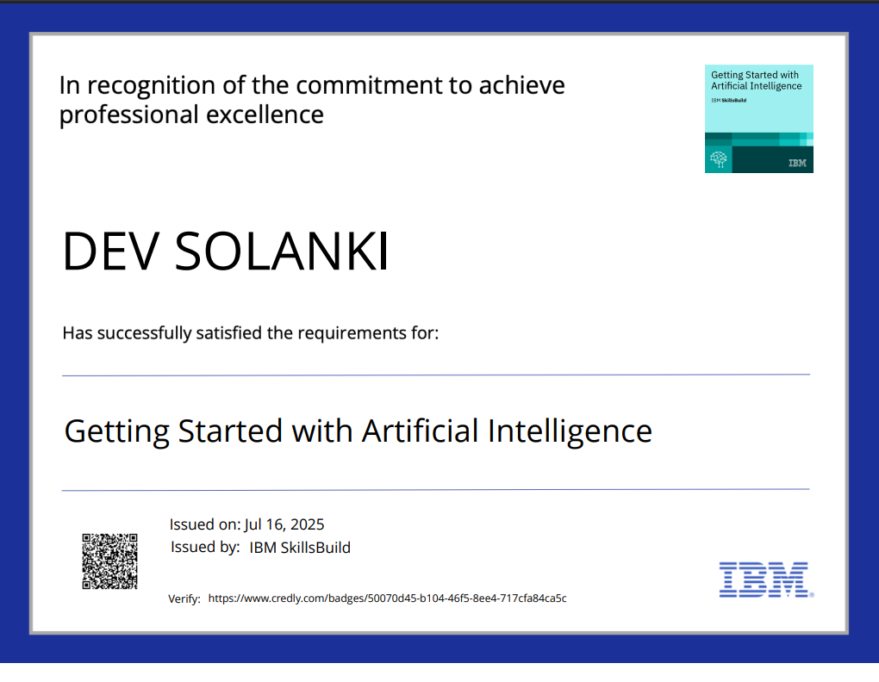
IBM Certifications
Screenshot/ credly certificate( getting started with AI)

Slide 16
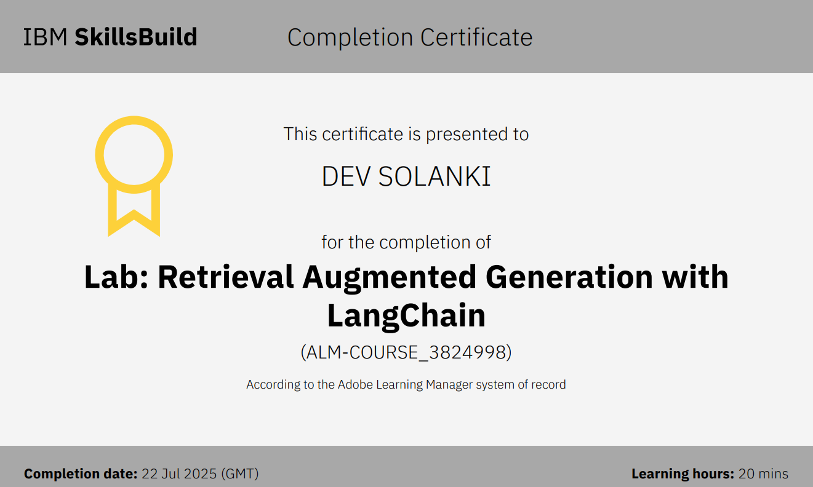
Attach your RAG LAB certificate here

Slide 17
THANK YOU

